Slide 1
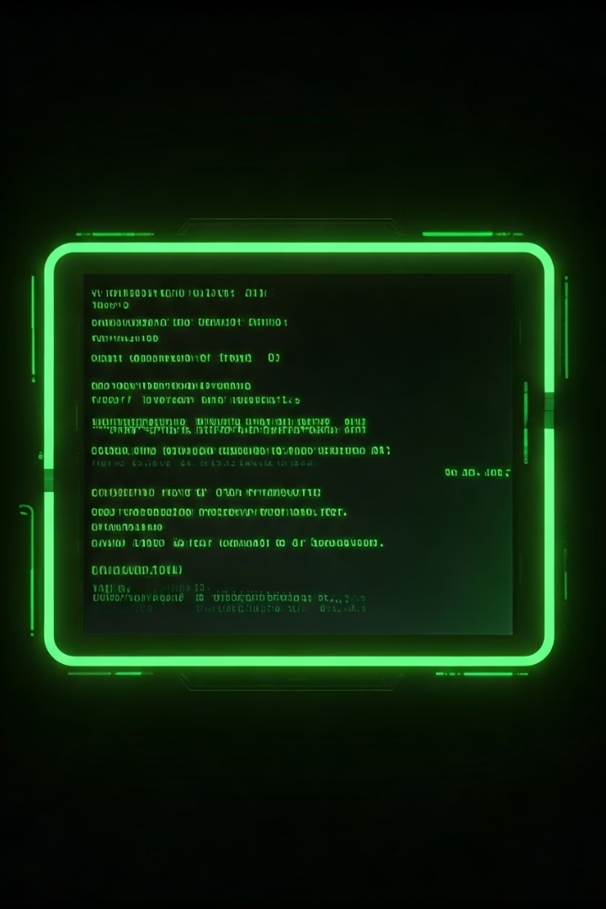

Python Pillow: Building a Command-Line Image Editor
Presentation by [Your Name]. This presentation overviews the Python Pillow library for image processing and demonstrates building a functional command-line image editing tool.
by Roshan Ravani Singh

Slide 2
Introduction to Pillow Library
Pillow Overview
Why Use Pillow?
Pillow is a fork of PIL, the Python Imaging Library.
Pillow simplifies image processing tasks.
Supports common formats like JPEG and PNG.
Easy to learn and use.
Manipulates images: open, edit, save.
Extensive documentation.
Integrates with Python workflows.
Large community support.

Slide 3
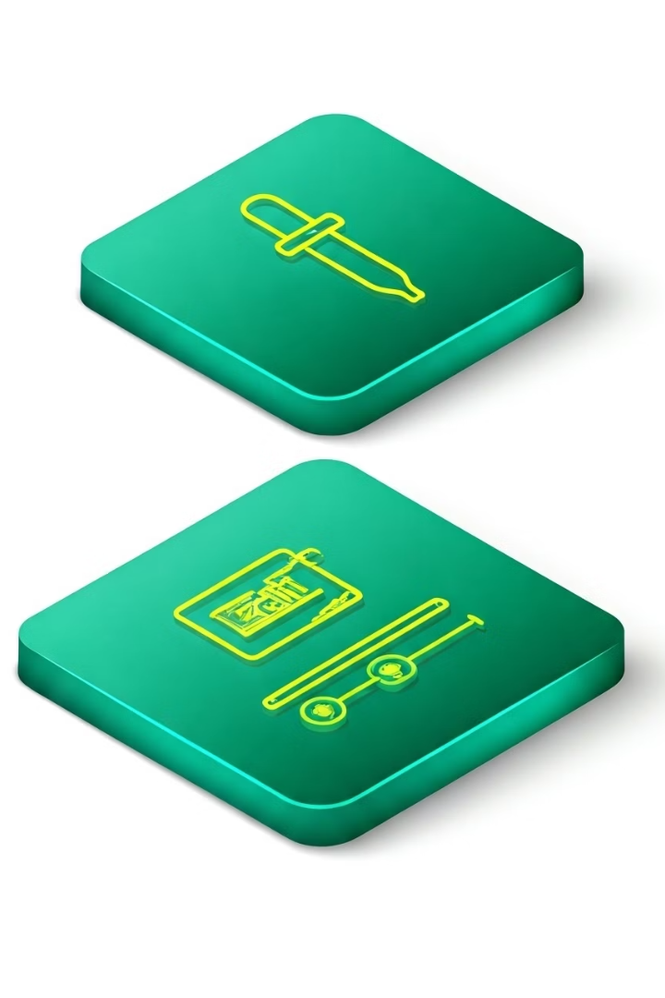




Key Features of Our Image Editor
Open and Display Images
Load images for editing.
Apply Filters
Enhance with effects.
Resize and Crop
Adjust dimensions.
Rotate and Flip
Change orientation.

Slide 4
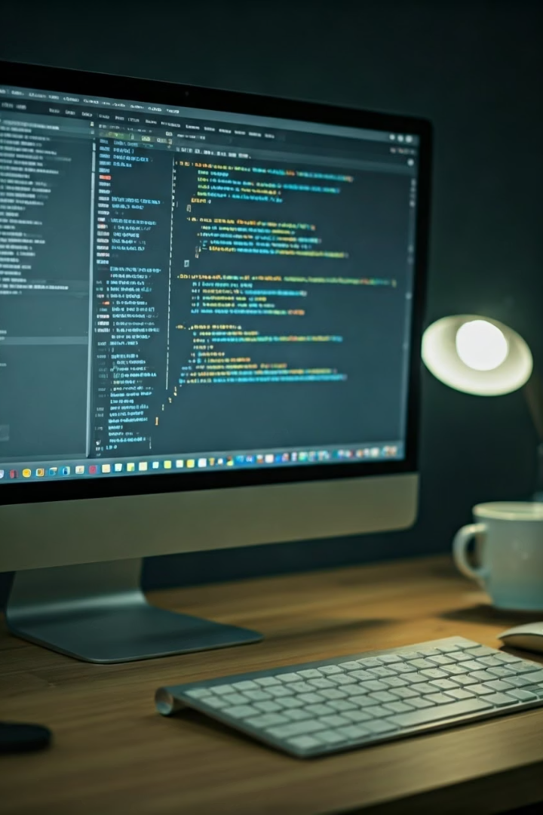
Opening and Displaying Images
Image.open()
Sample Image
Loads images using Image.open().
Demonstrate loading and displaying a sample image.
Exception Handling
Handles unsupported file formats gracefully.

Slide 5




Resizing and Cropping
Resizing
Keeps aspect ratio.
Cropping
Extracts regions with coordinates.
resize() and crop()
Methods for implementation.

Slide 6






Rotating and Flipping Images
Horizontal Flip
Mirrors image horizontally.
Rotation
90°, 180°, custom angles.
Vertical Flip
Mirrors image vertically.

Slide 7
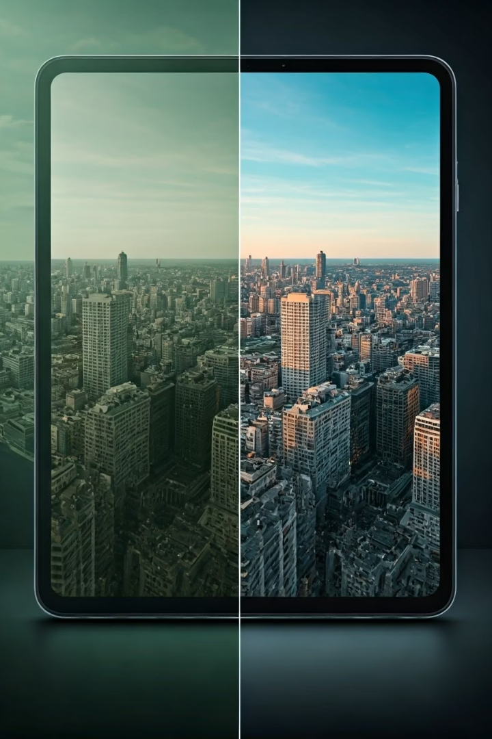
Applying Filters and Enhancements
1
Filters
Blur, sharpen, emboss, edge detection.
2
Color Enhancements
Brightness, contrast, sharpness adjustment.
3
ImageEnhance
Use ImageEnhance module.

Slide 8




Adding Text and Drawings
ImageDraw
Overlay text and shapes.
Watermarks
Add watermarks and annotations.
Customization
Font, size, color options.

Slide 9



Creating Collages and Format Conversion
1
Combine Images
2
Save
3
Formats
Combine multiple images into one. Save in different formats: JPEG, PNG, PDF.

Slide 10
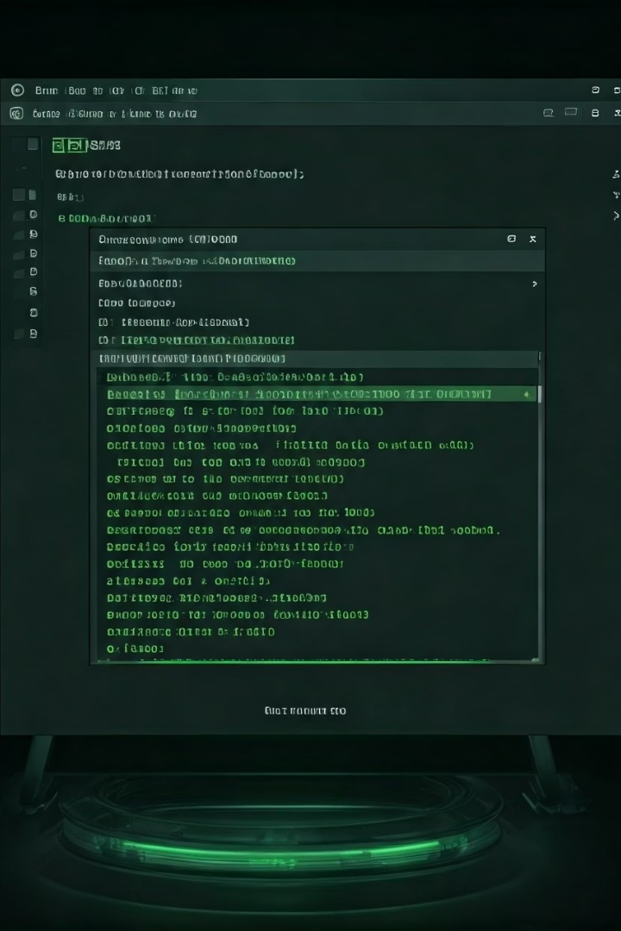
Summary and Final Output
Complete CLI Editor
Built with Pillow Library.
Future Additions
GUI implementation with Tkinter.
Scalability
Scalable code for real-world applications.

Slide 11
https://github.com/RavaniRoshan/Python-Assignment-3

